Slide 1
SOFTWARE PROJECT LAB
Team Members:
1. Eusha Abdullah – 180042127
2. Shahriar Ashfaq – 180042131
3. Timam Bin Saif – 180042117
Supervisor:
S.M. Sabit Bananee
Lecturer, IUT-CSE

Slide 2
PROJECT NAME
TradeFeed

Slide 3
PROBLEMS
Problem Statement:
In our daily life we need various types of services. Generally when we want service from a service provider we can’t easily get the best/ nearest person to accomplish it.
The amount of change hand between buyer and seller of the same item many times which eventually makes the product more expensive for the consumers.
Real Life Scenario:
When one move to a new place he/she faces hard time finding a service provider like electrician for installation of electric devices. There can be an application through which one can easily find an service provider.

Slide 4
SOLUTION
Simplifying and compacting the market of higher workforce
Finding right person or right product at ease
Reducing cost of products by reducing middle man
Increasing workforce by employing many

Slide 5
KEY FEATURES
Finding work
Hiring worker
Finding nearest Seller
Selling products

Slide 6
TECHNOLOGIES
For Programming languages we are using :
HTML5
CSS3
JavaScript
For Database we are using : Firebase

Slide 7
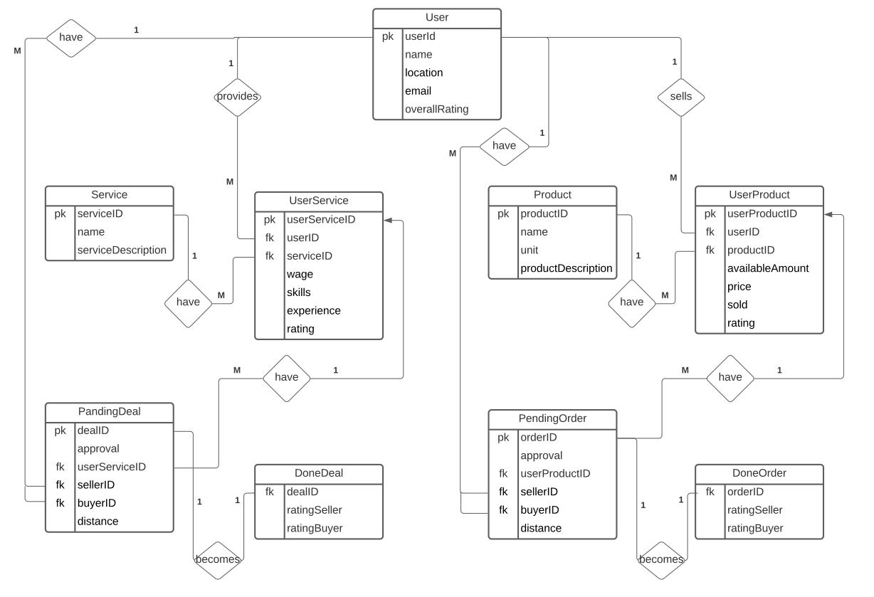
ER-Diagram

Slide 8
OUR PROJECT

Slide 9
THANK YOU

